Slide 1
Anglo-Saxon
Language & History
Brit LitA

Slide 2
MN ELA Standards
Writing 11.7.7.7 7 Conduct short as well as more sustained research projects to answer a question; narrow or broaden the inquiry when appropriate; synthesize multiple sources on the subject, demonstrating understanding of the subject under investigation.

Slide 3
MN ELA Standards
Speaking, Viewing, Listening, and Media Literacy 11.9.5.5 Make strategic use of digital media in presentations to enhance understanding of findings, reasoning, and evidence and to add interest.
11.9.6.6 Adapt speech to a variety of contexts, audiences, tasks, and feedback from self and others, demonstrating a command of formal English when indicated or appropriate.
  Apply assessment criteria to evaluate oral presentations by self and others.

Slide 4
Big Questions
Why do we have language?
How did English evolve?
What was Anglo-Saxon culture like?

Slide 5
Assessment
Group presentation (plus Works Cited page)

Slide 6
Why do we have language?
Theories
Unknown origin
Spoken before written
Notes:
Greek philosophers (Socrates and Plato) thought Greek was the divine language; the other languages were barbaric and not worth studying.

Slide 7
Why do we have language?
Theories
#1 Divine Explanation:
  Greek philosophers
  Language=a divine gift
  Religions have divine source that provides humans with language.
Problem: Why do peoples without religion have language?
Problem: Children who aren’t exposed to speech in their early years grow up with no language.
Notes:
Greek philosophers (Socrates and Plato) thought Greek was the divine language; the other languages were barbaric and not worth studying.
Many religions=many languages

Slide 8
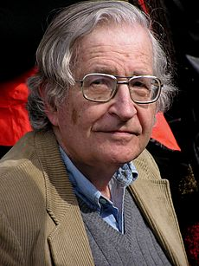
Why do we have language?
Theories
#2 Nativist Theory:
  Humans=biologically preprogrammed with ability to develop language
  Noam Chomsky
  Language acquisition device (LAD)
  Universal grammar
Notes:
http://languagedevelopment.tripod.com/id15.html
LAD contains knowledge of grammatical rules common to all languages
http://thebrain.mcgill.ca/flash/capsules/outil_rouge06.html

Slide 9
How did English evolve?
A Family Tree

Slide 10
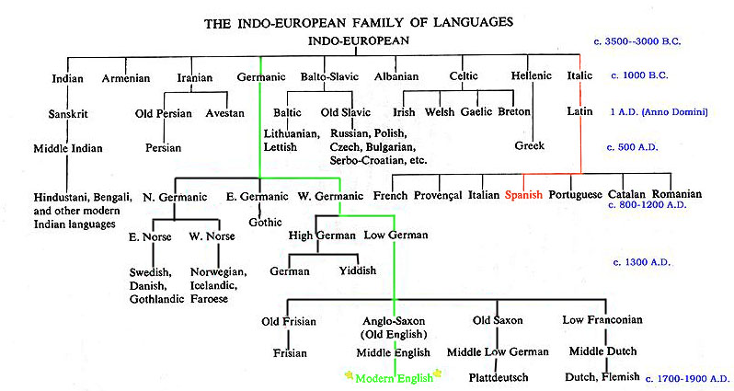
Notes:
Or: http://web.cn.edu/KWHEELER/IE_images/ietreecentum1_bw.gif

Slide 11
How did English evolve?
Maps

Slide 12
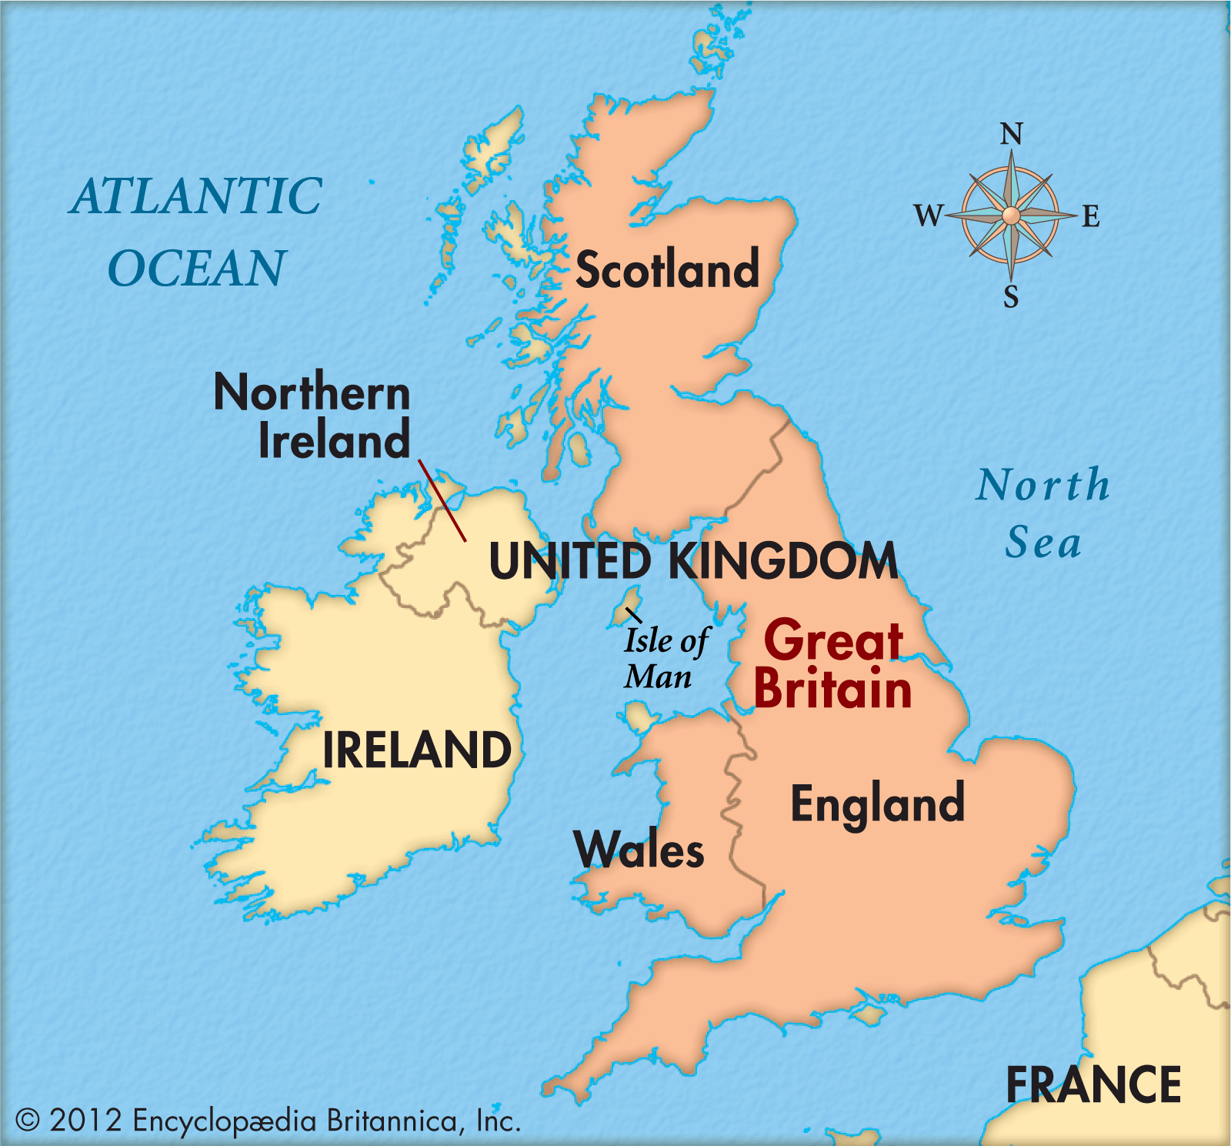

Slide 13
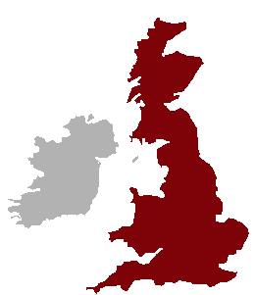

Slide 14
How did English evolve?
A Chronology
The Celts
The Romans
The Danes
The Anglo-Saxons and Jutes
  Beowulf!
Notes:
http://www.primaryhomeworkhelp.co.uk/saxons/timeline.htm

Slide 15
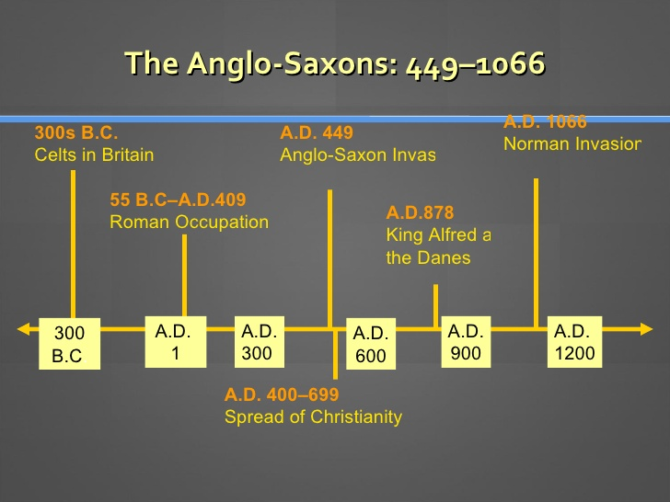

Slide 16
How did English evolve?
A History Webquest
Go to Ms. Vander Heiden’s website.
Under “Unit 2: Beowulf,” click on the appropriate link that corresponds with your topic.
Read and take notes. You and your partner should choose at least four important pieces of information to share with the class.
Topics:
  Celts (or Britons) (“Iron Age and Celtic Britain”)
  Romans
  Venerable Bede
  Danes (Vikings)
  Alfred the Great
  Anglo-Saxons and Jutes
Notes:
https://faculty.history.wisc.edu/sommerville/123/123%203%20prehist.htm
https://faculty.history.wisc.edu/sommerville/123/123%204%20roman.htm

Slide 17
The Celts
500 B.C.
Brythons and Gaels (two tribes)
  Brythons settled on largest island, Britain.
  Gaels settled on second largest island, Ireland.
Farmers and hunters
Organized tightly knit clans
Druids (High Priest)
  Settled disputes
  Presided over religious rituals
  Memorized and recited long, heroic poems that preserved the people’s myths about the past
Notes:
http://www.britainexpress.com/History/Celtic_Britain.htm

Slide 18

The Romans
55 B.C. – 407 A.D.
Julius Caesar invaded
Caesar established camps “castas” ---thus establishing many towns in England. Towns that end in “caster”, “cester”, “chester” are due to the Roman influence (Winchester, Lancaster, etc…)
Romans abandoned Britain to defend Italy
Brought Christianity
  Promoted peace
  Unified the English people
  Brought education and written literature – est. schools such as Canterbury & York

Slide 19
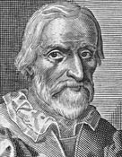
The Venerable Bede
Lived from 673 – 735 A.D.
Joined monastery; priest
Father of English History
  Wrote Ecclesiastical History of the English People
Wrote in Latin

Slide 20
The Danes
793 A.D.
Vikings (from Norway, Denmark, and Sweden)
Attacked England: destroyed manuscripts, stole religious objects, burned/ killed communities
No literary output

Slide 21
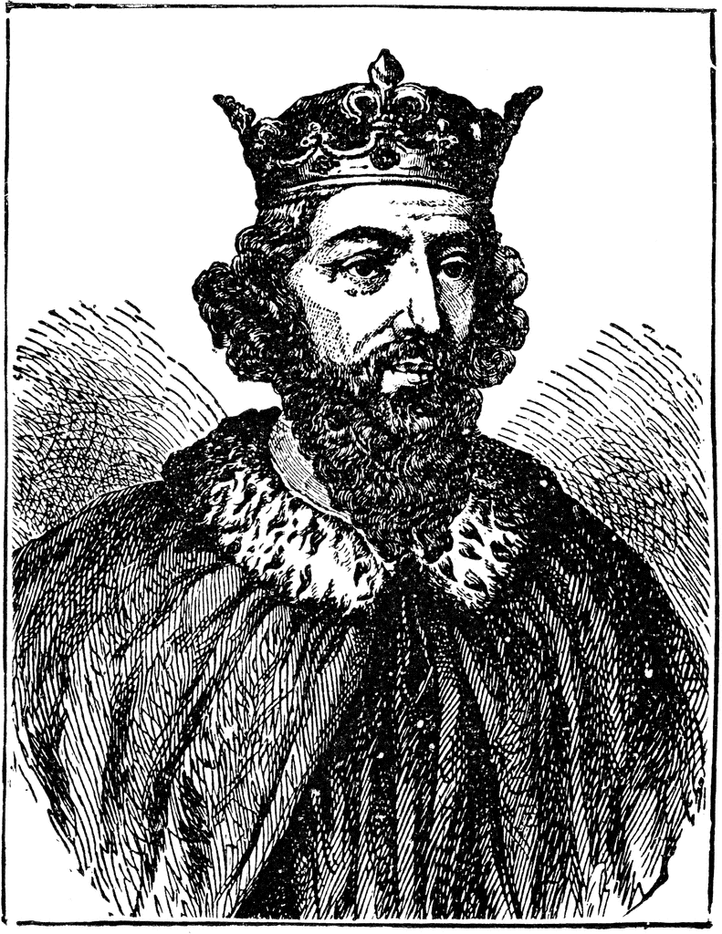
Alfred the Great
King of Wessex in 871
Defeated the Danes (Vikings)
Established Danelaw
  Line between England and Danish rule
Used English to unite people
Translated books from Latin to Anglo-Saxon
  Began Anglo-Saxon Chronicles
Notes:
Learned Latin when he was 40.

Slide 22
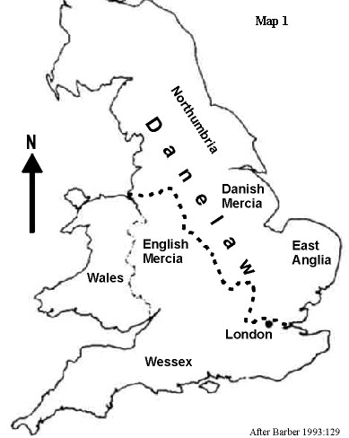

Slide 23
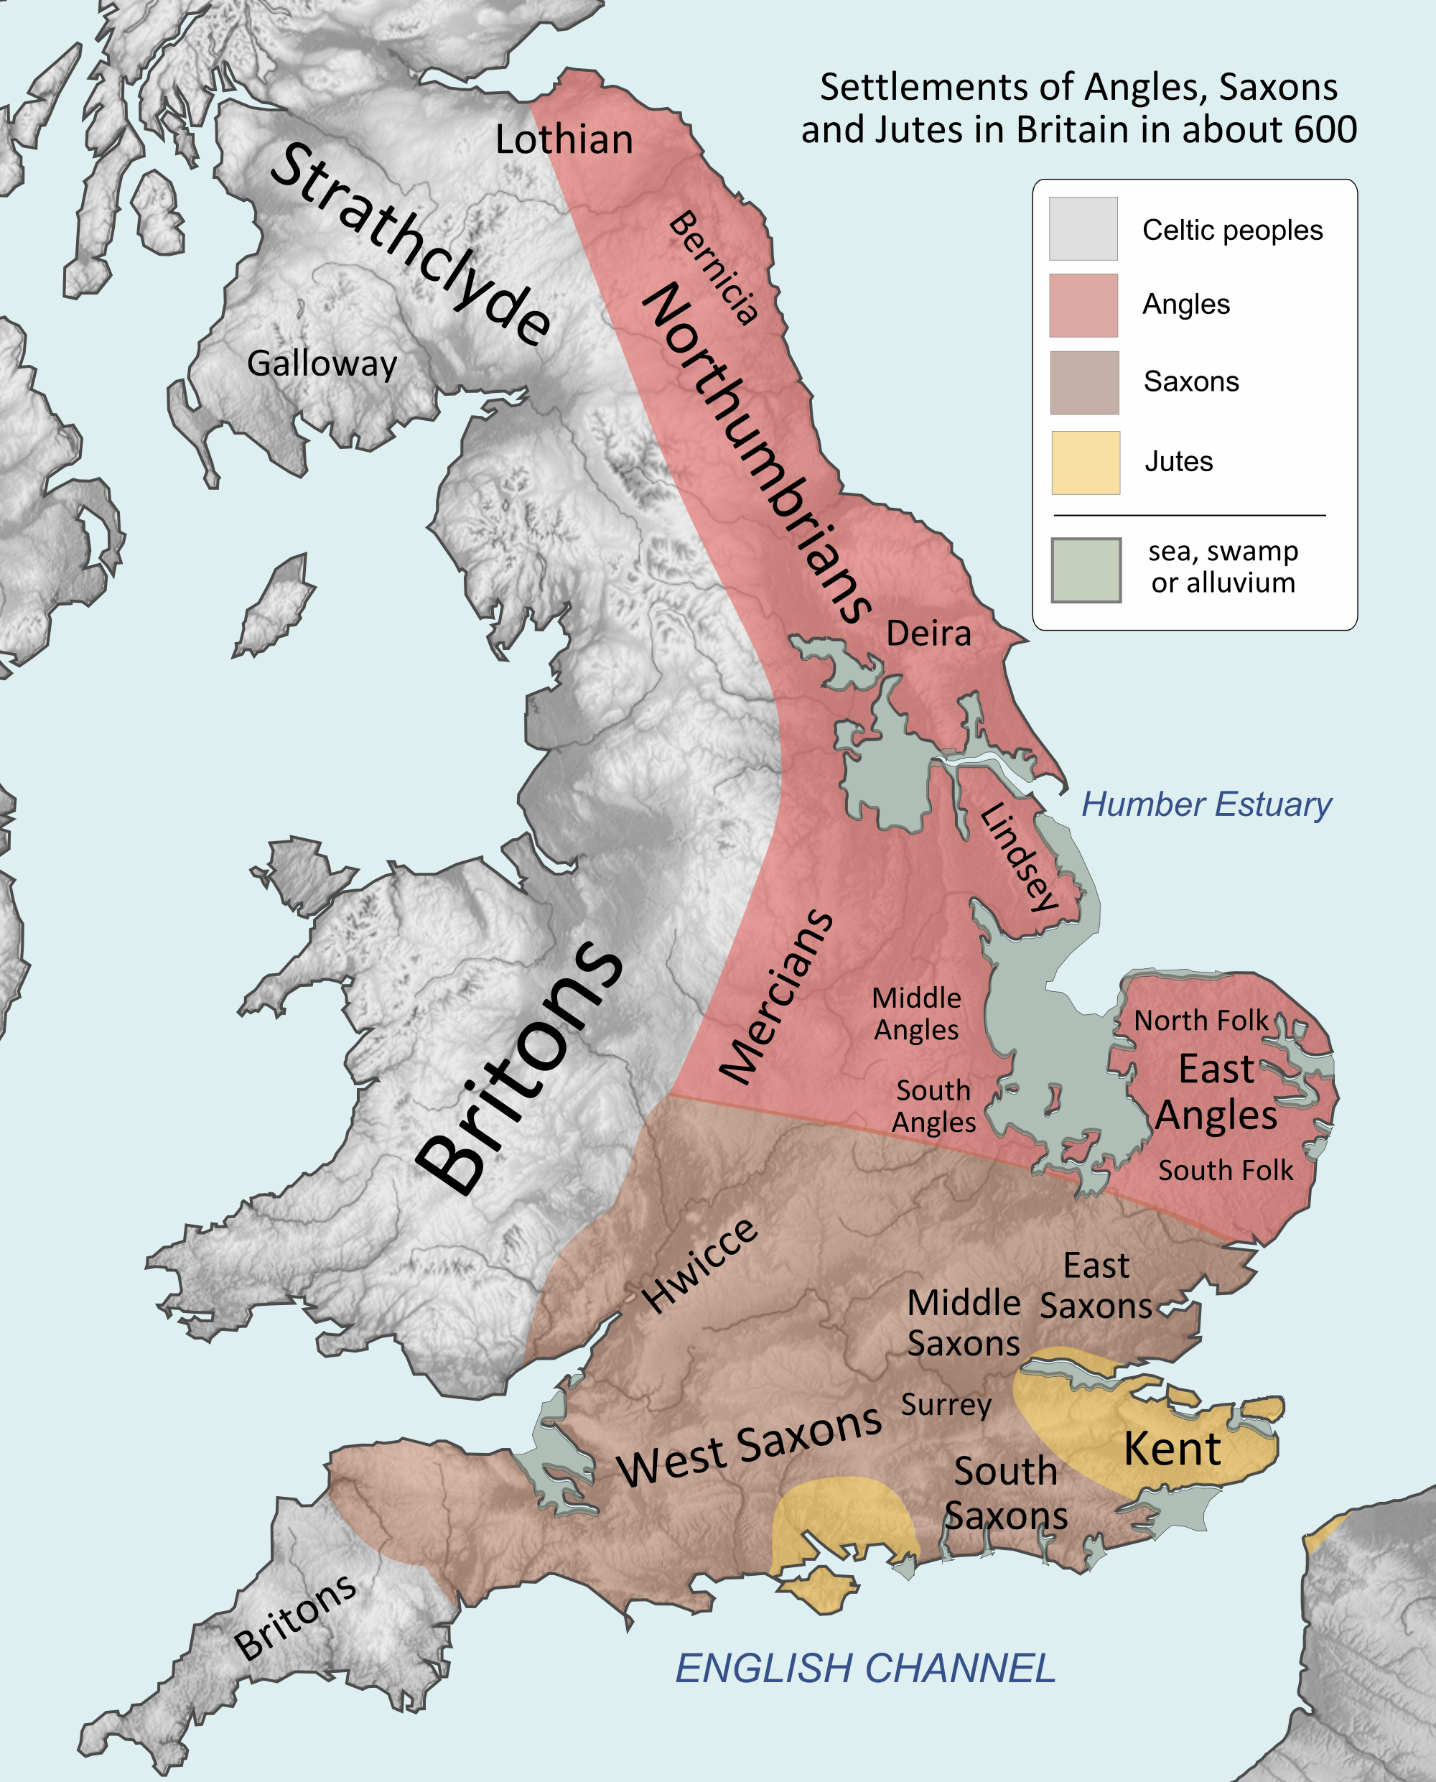
Anglo Saxons and Jutes

Slide 24
The Anglo-Saxons and Jutes
Germanic tribes invade
Tribal units controlled by king
  Chosen by WITAN (Witenagemot) – council of elders
Trade refined English
Angle-ish – English

Slide 25
Beowulf!
Anonymous
Written between 5th-11th centuries (probably 900 A.D.)
Oldest surviving significant piece of literature in English
Told about past
Foundational epic of English & British culture
  Iliad or the Odyssey

Slide 26
RADCAB: RA
RELEVANCY: Is the information relevant to the question? Am I on the right track?
APPROPRIATENESS: Is the information appropriate? Sources that make you feel confused or uneasy should be exited immediately. YOU are in charge.
  Your age
  Your values

Slide 27
RADCAB: DC
DETAIL: How much information do I need? Does the information offer me the depth of coverage I need for my project?
CURRENCY: What is the date of publication?
  Is this source a current source?

Slide 28
RADCAB: AB
AUTHORITY: Who is the author? What particular school, university, organization, company, or governmental agency is the author associated with?
  What other work (books, papers, studies, etc.) has s/he completed?
  Does this author have authority to write this? Why or why not?
BIAS: Is the source biased? Is the information trying to inform, persuade, entertain, or sell something?

Slide 29
Authority
In the cafeteria, you hear someone whisper, “Yeah, I heard Coach Max got fired! I can’t believe it!” Because Coach Max is your soccer coach, you want to know what the “story is” behind the comment.
  List two people you would turn to for information about the situation. Tell why you would choose those two people.

Slide 30
Authority
I need an assistant for the manager of a computer company. Who should I choose?
A. Cynthia Clive, who recently graduated from college with an English degree
B. Alfonso Martinez, who is a practicing lawyer in a neighboring town
C. Maria Cervantes, who graduated with a degree in Computer Science and has worked at the Apple computer store for the past five years

Slide 31
Authority
You are traveling through a very small town and see two, and only two, places to eat—McDonald’s and Don McAld’s.
Where will you eat and why?

Slide 32
Bias
the domain name, the domain suffix (.com, .edu, .gov, etc.)
the advertising
the mission statement
the authorship or organization behind the information
the tone of voice or language used
  Is the information trying to inform, persuade, entertain, or sell something?

