Slide 1
Beowulf Unit
Brit Lit A

Slide 2
Beowulf!
Anonymous
Written between 5th-11th centuries (probably 900 A.D.)
Oldest surviving significant piece of literature in English
Told about past
Foundational epic of English & British culture
Iliad or the Odyssey

Slide 3
Jabberwocky by Lewis Carroll
What happened?
With your partner, paraphrase the poem.
What strategies did you use to figure it out?

Slide 4
English
Old English (449-1100) Beowulf
Middle English (1100-1500)
Modern English (1500-Present)

Slide 5
Beowulf
Hwæt! We Gardena in geardagum,
þeodcyninga, þrym gefrunon,
hu ða æþelingas ellen fremedon.
Oft Scyld Scefing sceaþena þreatum,

Slide 6
Beowulf Translation: An Excerpt
Which phrases/words are repeated in some of the translations?
Choose one phrase/word that is different in all three. Analyze it:
What does each phrase mean?
How are they different?
Why do you think they are different?
Which phrase do you prefer and why?

Slide 7
Beowulf Translation: An Excerpt
Is one translation right?
Is one better?
Is one more appealing?

Slide 8
Beowulf Language
alliteration:
repetition of stressed sounds, particularly consonants from the beginning of words/syllables

Slide 9
Beowulf Language
2. compounding
kenning

Slide 10
Beowulf Language
2. compounding: combining of two words to make a new word
Ex: “Spear-Danes” or “life-sick”
kenning

Slide 11
Beowulf Language
2. compounding: combining of two words to make a new word
Ex: “Spear-Danes” or “life-sick”
kenning: metaphoric compounding
Ex: “bone-house”
“whale’s road”
“sky’s candle”

Slide 12
Beowulf Language
Identify examples of alliteration and compounding in the first three lines and in Raffel’s translation.

Slide 13
Characters/Names
King Hrothgar (Halfdane’s son): King of Spear-Danes (a certain tribe)
Queen Welthow: married to Hrothgar
Herot=King Hrothgar’s wealthy hall where his warriors gather to drink and feast
Herot means “hart”
Grendel=demon
Beowulf=warrior
Tribe of Weather-Geats (living in what is Sweden today)

Slide 14
Film Comparison: Herot & Beowulf
How does the film portray Grendel?
Describe the film’s interpretation of Herot Hall.
How does Beowulf compare to the text description?
How is Beowulf’s landing similar and different?
How is Beowulf’s speech different?
How does the film portray Hrothgar?

Slide 15
Finished with quiz?
Pick up a Grendel Transformation Assignment and read it.
Writing 11.7.3.3 I can write creative texts in first person point of view with well-chosen textual details.

Slide 16
Grendel Transformation Rewrite: POV
Writing 11.7.3.3 I can write creative texts in first person point of view with well-chosen textual details.
With your group, brainstorm a list of emotions that Grendel and Beowulf feel in Sections 11 and 12.
Section 11: Section 12:
(at least 2 (at least 2
emotions each) emotions each)

Slide 17
Language Practice
Learning Target Language 11.11.5.5
I can understand figurative language, word relationships, and alliteration in context.

Slide 18
Language Practice
Learning Target Language 11.11.5.5 I can understand figurative language, word relationships, and alliteration in context.
With your group, identify any alliteration, compounding, or kennings in your section. Record the line numbers, too.
P. 17-18 7. P. 17-18
P. 22-23 8. P. 27-28
P. 24-25
P. 25-26
P. 27-28
P.28-29

Slide 19
Language Practice
Learning Target Language 11.11.5.5 I can understand figurative language, word relationships, and alliteration in context.
With your group, answer the following:
What do the compounds or kennings mean?
What effect does alliteration have on the overall poem? (In other words, why did the scop use alliteration?)

Slide 20
Language Practice
Learning Target Language 11.11.5.5 I can understand figurative language, word relationships, and alliteration in context.
On your note card, record one piece of figurative language and explain why it’s important.
Develop your own original compound or kenning.

Slide 21
Your Compound or Kenning
Write your own compound or kenning.
Ex: snow-filth
Ex: crystal-stars

Slide 22
Grendel Guide
Learning Target Reading 11.4.1.1 I can cite strong and thorough textual evidence to support my inferences.

Slide 23
Grendel by John Gardner
Write:
How has Gardner changed your perception of Grendel?
What is one aspect of Gardner’s re-telling that is done particularly well?
What surprised you about Gardner’s re-telling?

Slide 24
Perspectives
Write a few statements or a short conversation from the perspective of your role about how you are feeling:
At the beginning of Section 13. (How do you feel?)
At the end of Section 20. (How do you feel?)

Slide 25
Religion
Find three references to religion or religious ideas in any section.
Record the quotes.
Explain what the quotes (religious references) mean.

Slide 26
Film Comparison: Grendel’s Mother
How do you picture Grendel’s mother? Draw it.
How does the film depict Grendel’s mother?

Slide 27
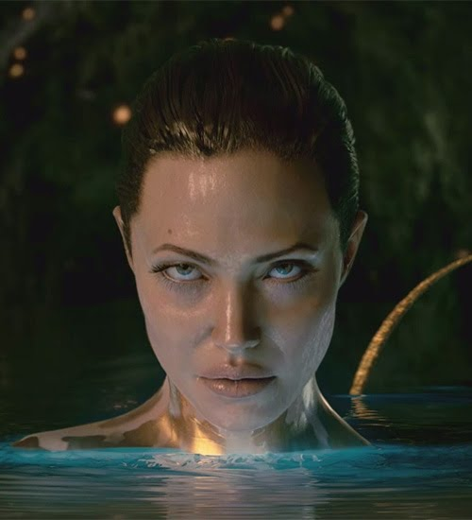

Slide 28
A Survey
Go to Ms. Vander Heiden’s website.
Click on, “Gendered Words Survey” under “Unit 2: Beowulf.”
Take the survey.

Slide 29
Gender Lens
Relationship between men and women=unequal
Traditionally, male dominated.
Applying the gender lens means:
Examining the portrayal of characters, both female and male
Analyzing the language of the text and the attitude of the author
Analyzing gender stereotypes and the relationship between the characters
Examining what the author seems to be saying about society as a whole.

Slide 30
Section 24-26
Record at least three references to religion or religious ideas in these sections.
Explain what the quotes (religious references) mean.
What advice does Hrothgar give about wealth?

Slide 31
Section 27-31
Record at least three instances where gender is mentioned in these sections.
Apply the gender lens to the passages; analyze the poet’s commentary on gender.

Slide 32
Film Comparison: Dragon
How is the movie plot different than the text?
Describe the film’s dragon.

Slide 33
Finished with the exam?
Choose a second topic from the bag.
Ex: wealth
Change the topic into a lesson learned or a message (i.e. a theme). Write it down.
Ex: Don’t hold on to your earthly possessions too tightly.
Support your theme with at least two specific examples (lines) from the text. Write them down.
Look at the sample projects on Ms. VH’s website (slideshow).
Work on your theme project.

Slide 34
Themes: Practice
Choose a general topic from the bag.
Ex: wealth
With your partner, change the topic into a lesson learned or a message (i.e. a theme). Write it down.
Ex: Don’t hold on to your earthly possessions too tightly.
Support your theme with at least two specific examples (lines) from the text. Write them down.

Slide 35
Finished with the timed essay?
Grab a Daily Work Log.
Record your goal and accomplishment from last Friday.
Take a quiet mental break for at least 3 minutes.
Plan your goal for our work day tomorrow.

Slide 36
Goal
Write a goal for today. What will you accomplish?
Explain what you accomplished today.

Slide 37
Tweet Sample
“D’you recall my dad—Ecgtheow? A most famous warrior (I know I take after him). We’ve heard of your monster and we’ve come to help Hrothgar.”

